Slide 1
CHAPTER 7
Optimal Risky Portfolios

Slide 2
The Investment Decision
7-<number>
Top-down process with 3 steps:
Capital allocation between the risky portfolio and risk-free asset
Asset allocation across broad asset classes
Security selection of individual assets within each asset class

Slide 3
Diversification and Portfolio Risk
7-<number>
Market risk
  Systematic or nondiversifiable
Firm-specific risk
  Diversifiable or nonsystematic

Slide 4
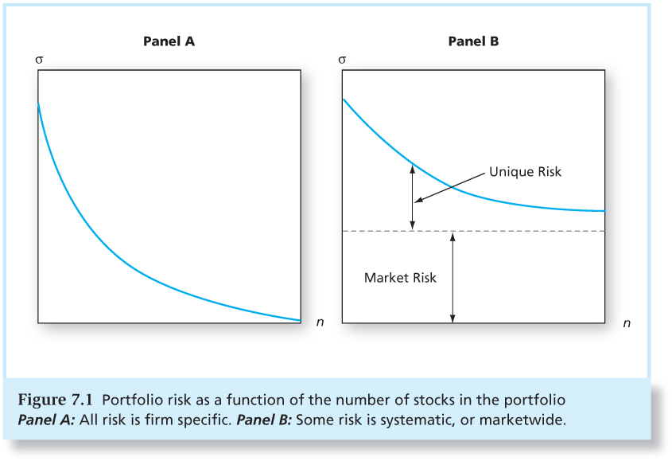
Figure 7.1 Portfolio Risk as a Function of the Number of Stocks in the Portfolio
7-<number>

Slide 5
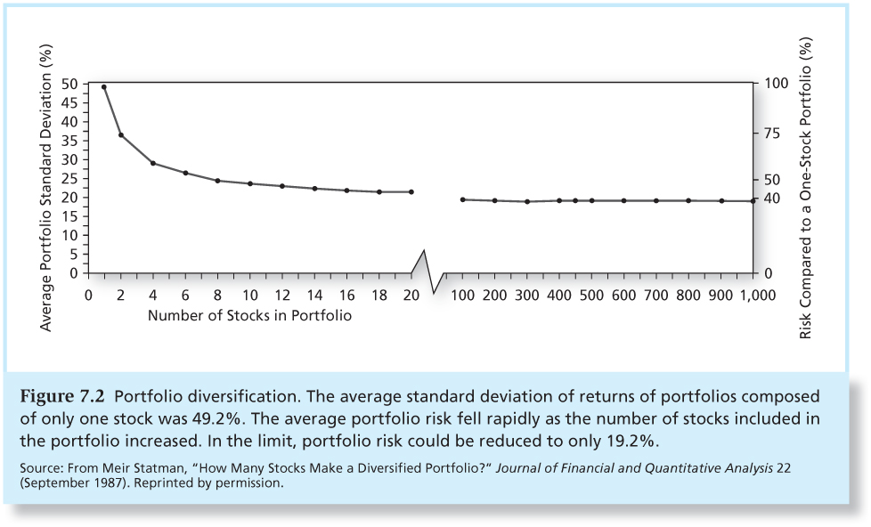
Figure 7.2 Portfolio Diversification
7-<number>

Slide 6
Covariance and Correlation
7-<number>
Portfolio risk depends on the correlation between the returns of the assets in the portfolio
Covariance and the correlation coefficient provide a measure of the way returns of two assets vary

Slide 7
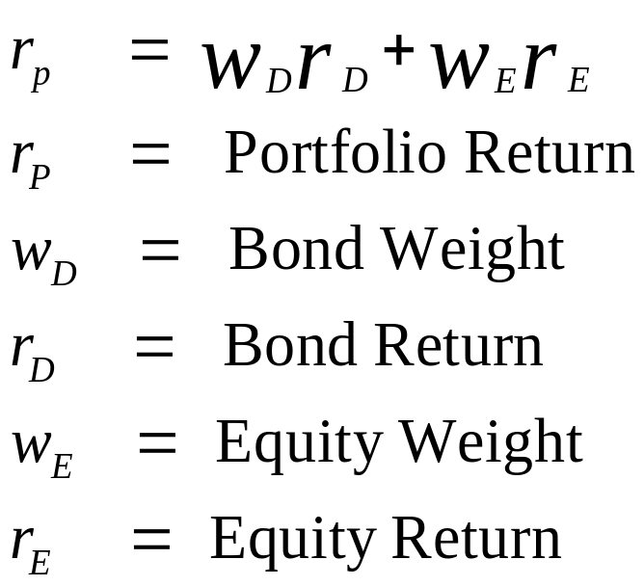
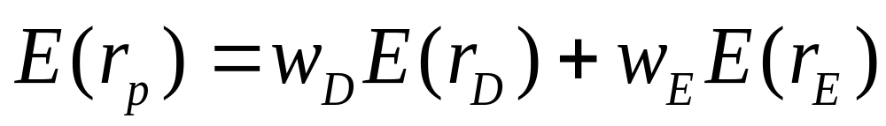
Two-Security Portfolio: Return
7-<number>

Slide 8
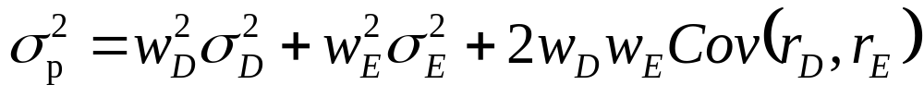
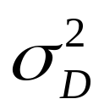
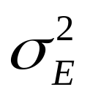
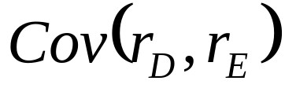
Two-Security Portfolio: Risk
7-<number>
= Variance of Security D
= Variance of Security E
= Covariance of returns for
Security D and Security E

Slide 9
Two-Security Portfolio: Risk
7-<number>
Another way to express variance of the portfolio:

Slide 10
Covariance
7-<number>
Cov(r_{D,}r_{E}) = ρ_{DE}σ_{D}σ_{E}
ρ_{D,E} = Correlation coefficient of
returns
σ_{D} = Standard deviation of
returns for Security D
σ_{E} = Standard deviation of
returns for Security E

Slide 11
Correlation Coefficients: Possible Values
7-<number>
Range of values for ρ_{1,2}
+ 1.0 > ρ > -1.0
If ρ = 1.0, the securities are perfectly positively correlated
If ρ = - 1.0, the securities are perfectly negatively correlated

Slide 12
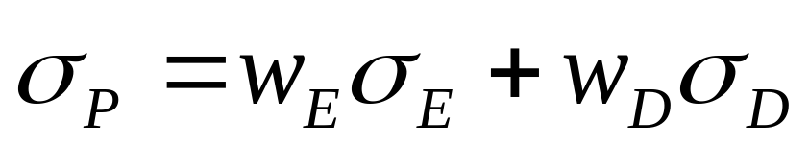
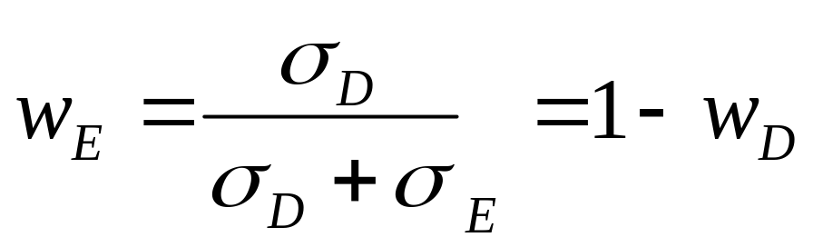
Correlation Coefficients
7-<number>
When ρ_{DE} = 1, there is no diversification
When ρ_{DE} = -1, a perfect hedge is possible

Slide 13
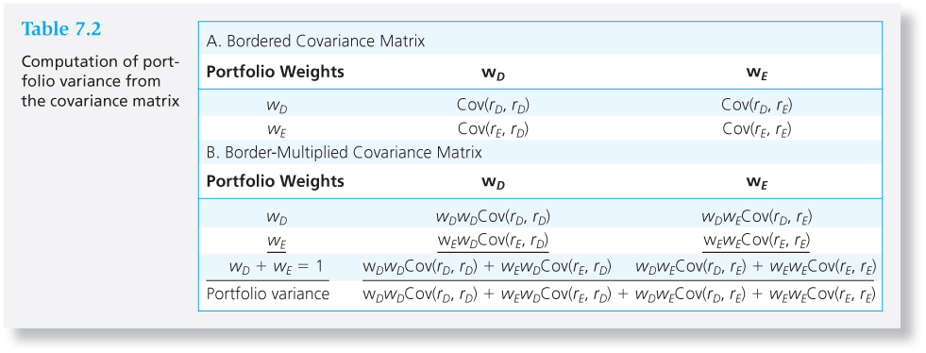
Table 7.2 Computation of Portfolio Variance From the Covariance Matrix
7-<number>

Slide 14
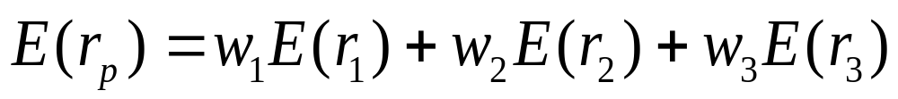
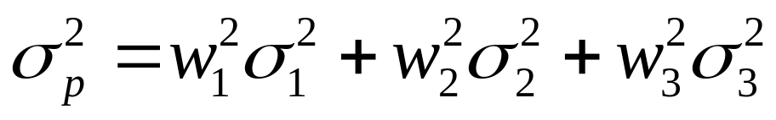
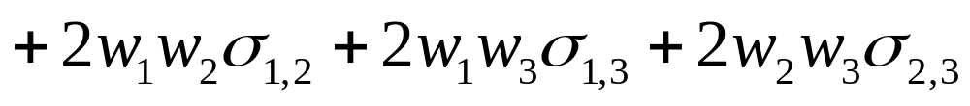
Three-Asset Portfolio
7-<number>

Slide 15
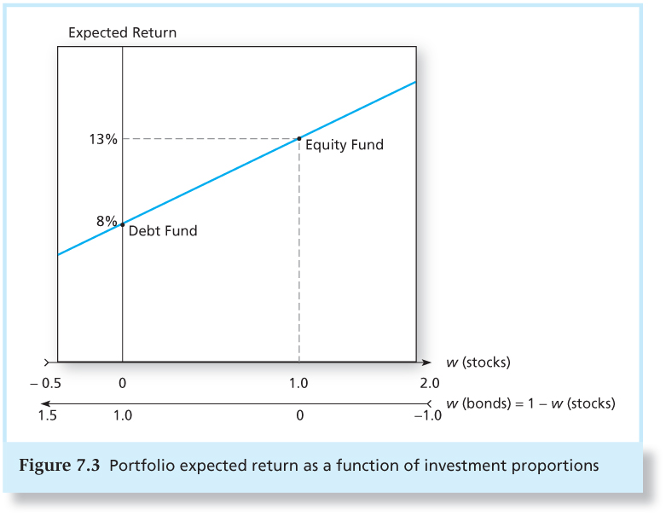
Figure 7.3 Portfolio Expected Return as a Function of Investment Proportions
7-<number>

Slide 16
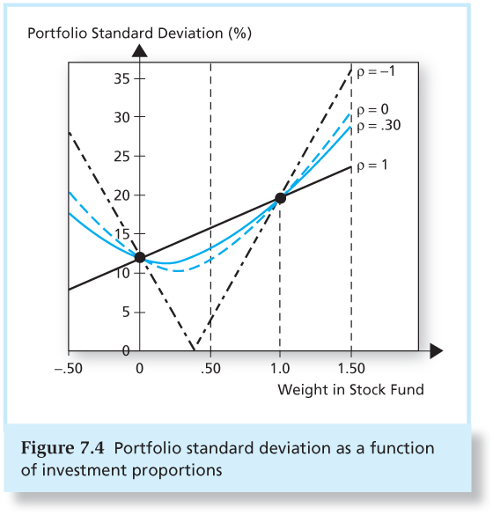
Figure 7.4 Portfolio Standard Deviation as a Function of Investment Proportions
7-<number>

Slide 17
The Minimum Variance Portfolio
7-<number>
The minimum variance portfolio is the portfolio composed of the risky assets that has the smallest standard deviation, the portfolio with least risk.
When correlation is less than +1, the portfolio standard deviation may be smaller than that of either of the individual component assets.
When correlation is -1, the standard deviation of the minimum variance portfolio is zero.

Slide 18
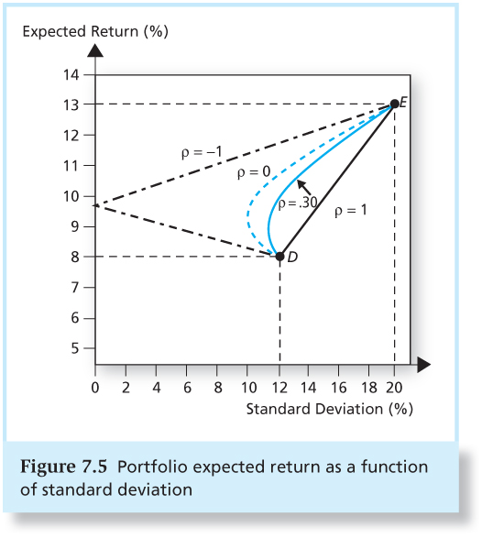
Figure 7.5 Portfolio Expected Return as a Function of Standard Deviation
7-<number>

Slide 19
Correlation Effects
7-<number>
The amount of possible risk reduction through diversification depends on the correlation.
The risk reduction potential increases as the correlation approaches -1.
  If ρ = +1.0, no risk reduction is possible.
  If ρ = 0, σ_{P} may be less than the standard deviation of either component asset.
  If ρ = -1.0, a riskless hedge is possible.

Slide 20
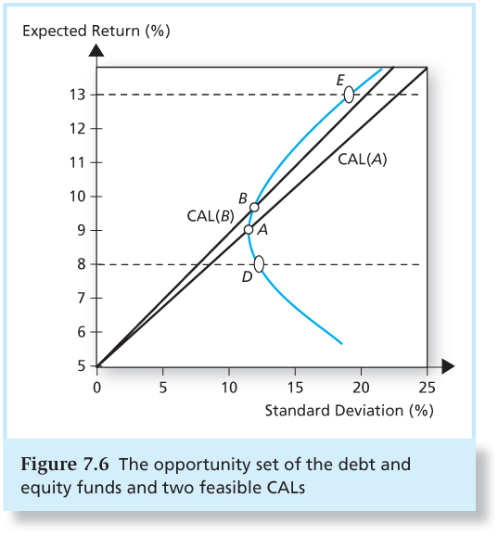
Figure 7.6 The Opportunity Set of the Debt and Equity Funds and Two Feasible CALs
7-<number>

Slide 21
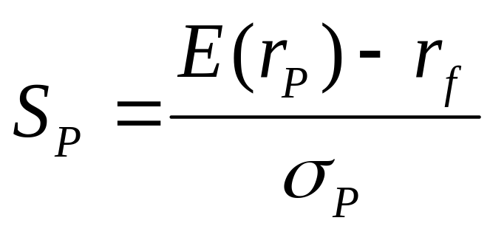
The Sharpe Ratio
7-<number>
Maximize the slope of the CAL for any possible portfolio, P.
The objective function is the slope:
The slope is also the Sharpe ratio.

Slide 22
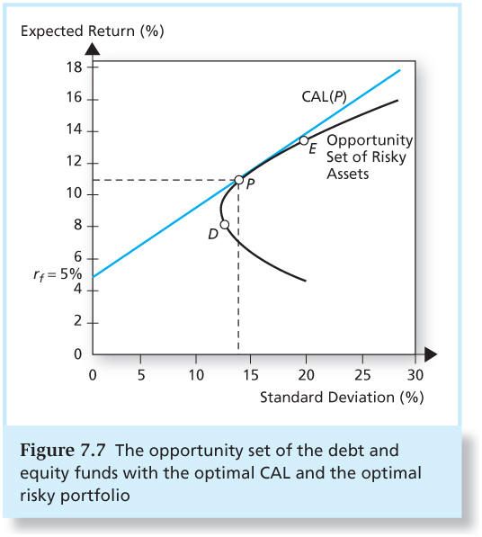
Figure 7.7 The Opportunity Set of the Debt and Equity Funds with the Optimal CAL and the Optimal Risky Portfolio
7-<number>

Slide 23
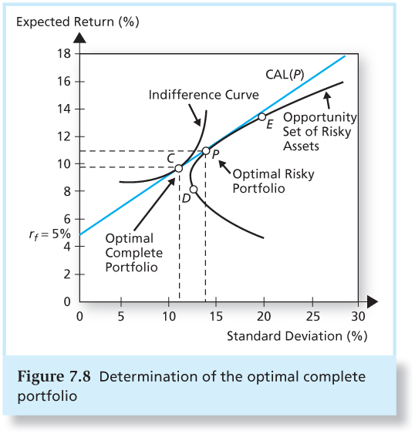
Figure 7.8 Determination of the Optimal Overall Portfolio
7-<number>

Slide 24
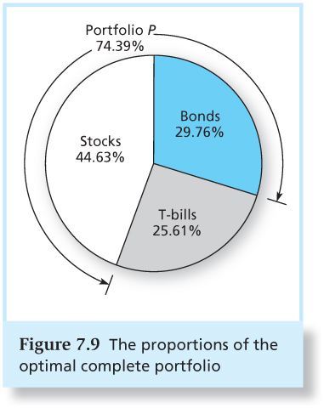
Figure 7.9 The Proportions of the Optimal Overall Portfolio
7-<number>

Slide 25
Markowitz Portfolio Selection Model
7-<number>
Security Selection
  The first step is to determine the risk-return opportunities available.
  All portfolios that lie on the minimum-variance frontier from the global minimum-variance portfolio and upward provide the best risk-return combinations

Slide 26
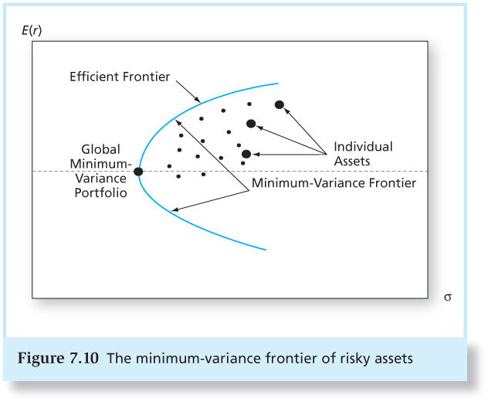
Figure 7.10 The Minimum-Variance Frontier of Risky Assets
7-<number>

Slide 27
Markowitz Portfolio Selection Model
7-<number>
We now search for the CAL with the highest reward-to-variability ratio

Slide 28
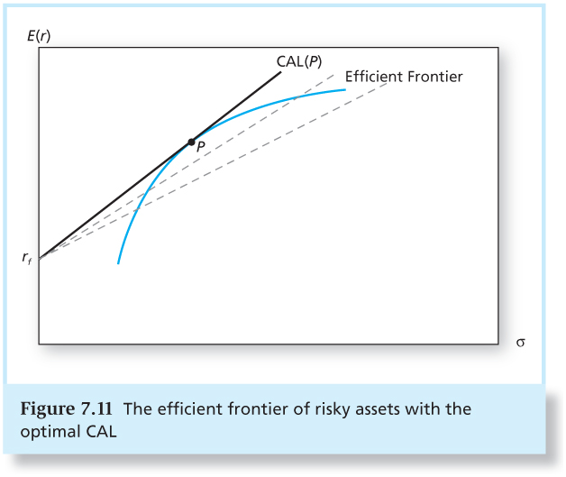
Figure 7.11 The Efficient Frontier of Risky Assets with the Optimal CAL
7-<number>

Slide 29
Markowitz Portfolio Selection Model
7-<number>
Everyone invests in P, regardless of their degree of risk aversion.
  More risk averse investors put more in the risk-free asset.
  Less risk averse investors put more in P.

Slide 30
Capital Allocation and the
Separation Property
7-<number>
The separation property tells us that the portfolio choice problem may be separated into two independent tasks
  Determination of the optimal risky portfolio is purely technical.
  Allocation of the complete portfolio to T-bills versus the risky portfolio depends on personal preference.

Slide 31
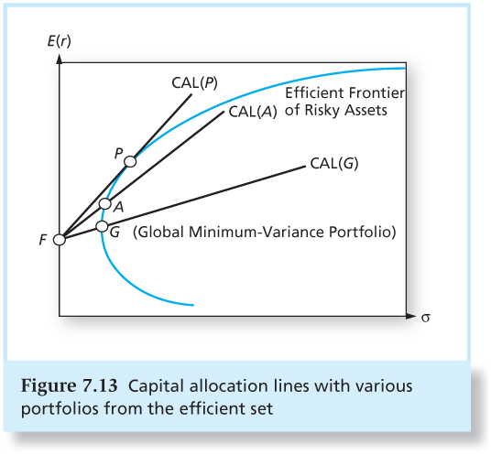
Figure 7.13 Capital Allocation Lines with Various Portfolios from the Efficient Set
7-<number>

Slide 32
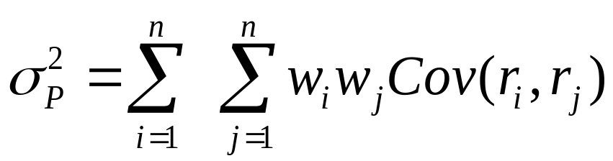
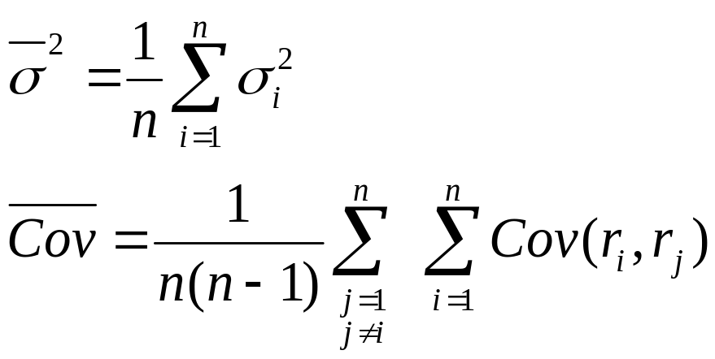
The Power of Diversification
7-<number>
Remember:
If we define the average variance and average covariance of the securities as:

Slide 33
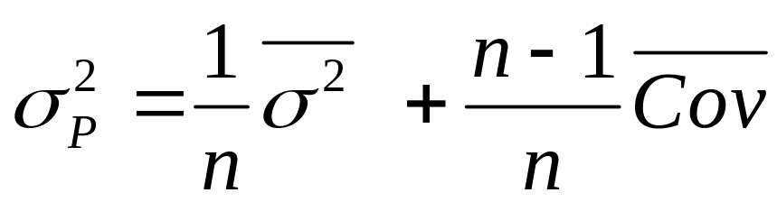
The Power of Diversification
7-<number>
We can then express portfolio variance as:

Slide 34
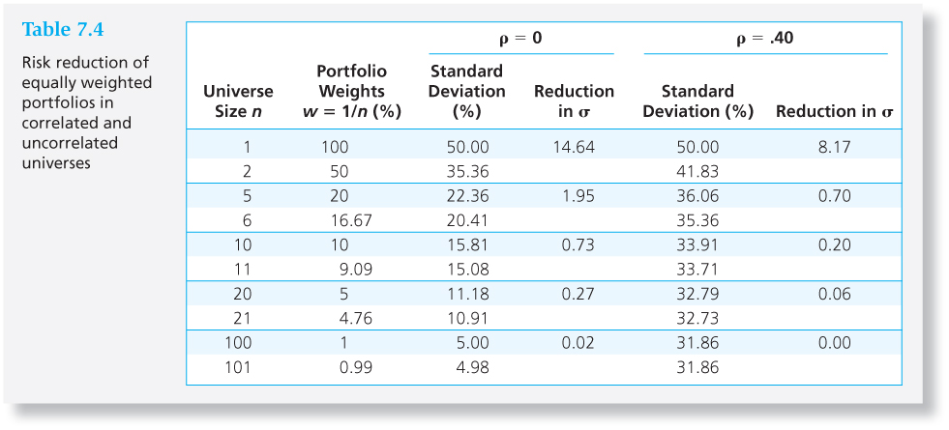
Table 7.4 Risk Reduction of Equally Weighted Portfolios in Correlated and Uncorrelated Universes
7-<number>

Slide 35
Optimal Portfolios and Nonnormal Returns
7-<number>
Fat-tailed distributions can result in extreme values of VaR and ES and encourage smaller allocations to the risky portfolio.
If other portfolios provide sufficiently better VaR and ES values than the mean-variance efficient portfolio, we may prefer these when faced with fat-tailed distributions.

Slide 36
Risk Pooling and the Insurance Principle
7-<number>
Risk pooling: merging uncorrelated, risky projects as a means to reduce risk.
  increases the scale of the risky investment by adding additional uncorrelated assets.
The insurance principle: risk increases less than proportionally to the number of policies insured when the policies are uncorrelated
  Sharpe ratio increases

Slide 37
Risk Sharing
7-<number>
As risky assets are added to the portfolio, a portion of the pool is sold to maintain a risky portfolio of fixed size.
Risk sharing combined with risk pooling is the key to the insurance industry.
True diversification means spreading a portfolio of fixed size across many assets, not merely adding more risky bets to an ever-growing risky portfolio.

Slide 38
Investment for the Long Run
7-<number>
Long Term Strategy
Short Term Strategy
Invest in the risky portfolio for 2 years.
  Long-term strategy is riskier.
  Risk can be reduced by selling some of the risky assets in year 2.
  “Time diversification” is not true diversification.
Invest in the risky portfolio for 1 year and in the risk-free asset for the second year.

